Slide 1


What Is a Computer?
HANA ADEN

Slide 2
UNDERSTANDING COMPUTERS
Defining a Computer and Its Uses
A computer is an electronic device that stores, retrieves, and processes data, enabling various tasks like typing, emailing, and gaming.
EVERYDAY APPLICATIONS
Common uses include browsing the internet, editing spreadsheets and videos, demonstrating the broad functionality of computers in everyday life.

Slide 3

The Role of Computers in Daily Activities
ENHANCING EVERYDAY PRODUCTIVITY
Computers significantly improve productivity by enabling tasks like communication, entertainment, research, and creative work, making everyday life more efficient and enjoyable.

Slide 4
UNDERSTANDING HARDWARE
Hardware and Software Explained
Hardware refers to the physical components of a computer, including the keyboard, mouse, monitor, and internal mechanisms that make it function.
UNDERSTANDING SOFTWARE
Software consists of instructions and programs that tell the hardware how to perform tasks, such as web browsing, gaming, and word processing.

Slide 5
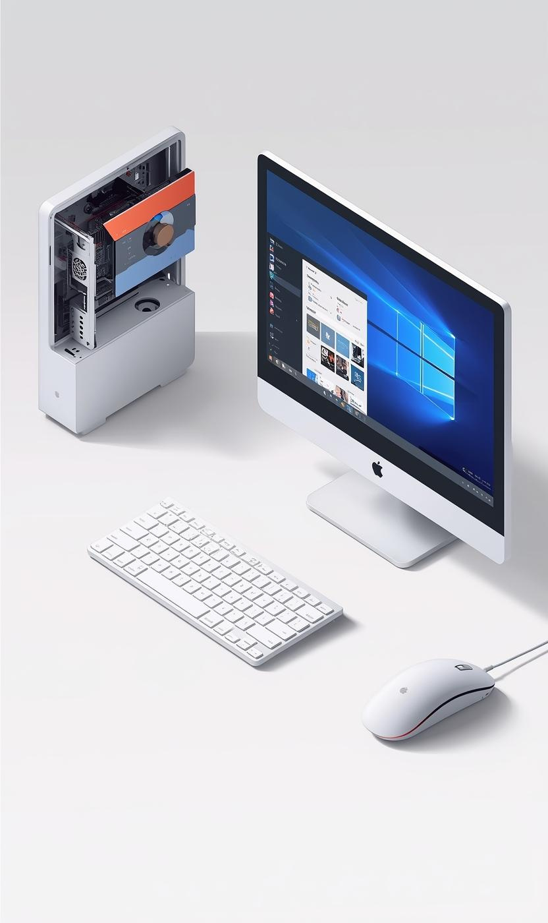
Understanding Hardware: The Physical Components
ESSENTIAL PARTS OF A COMPUTER
Hardware includes all the physical parts of a computer, such as the keyboard, mouse, monitor, and internal components, enabling data interaction.

Slide 6
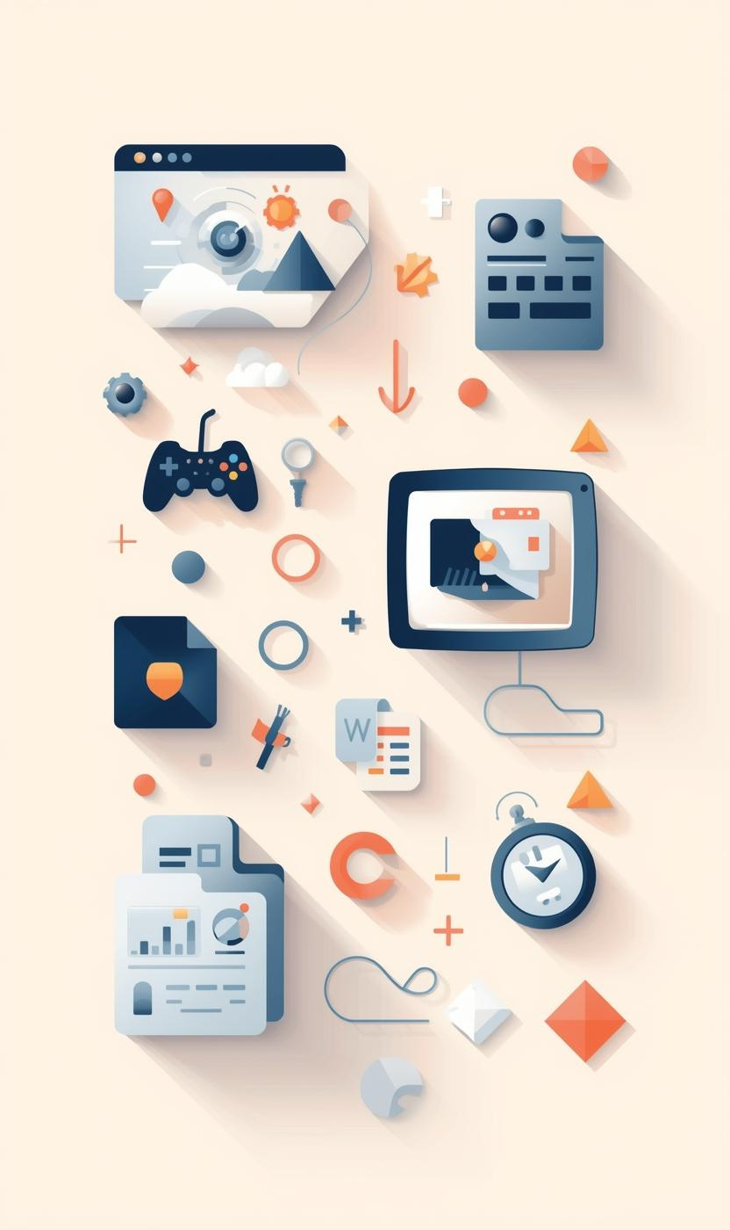
Software: Understanding Instructions for Hardware
THE ROLE OF SOFTWARE
Software consists of programs and applications that instruct hardware on performing tasks, including web browsing, gaming, and document creation.

Slide 7

Types of Computers
DESKTOP
LAPTOP
TABLET
Desktop computers are stationary devices that typically consist of multiple parts, including a monitor, keyboard, mouse, and CPU unit.
Laptops are portable computers that feature integrated components and run on battery power, allowing for convenient use anywhere and anytime.
Tablets are handheld devices with touchscreen interfaces, highly portable and perfect for browsing, gaming, and media consumption on the go.

Slide 8

Desktop Computers: Stationary and Versatile Machines
UNDERSTANDING DESKTOP COMPUTER COMPONENTS
Desktop computers consist of multiple parts, including a case, monitor, keyboard, and mouse, making them ideal for home, school, and office use.

Slide 9
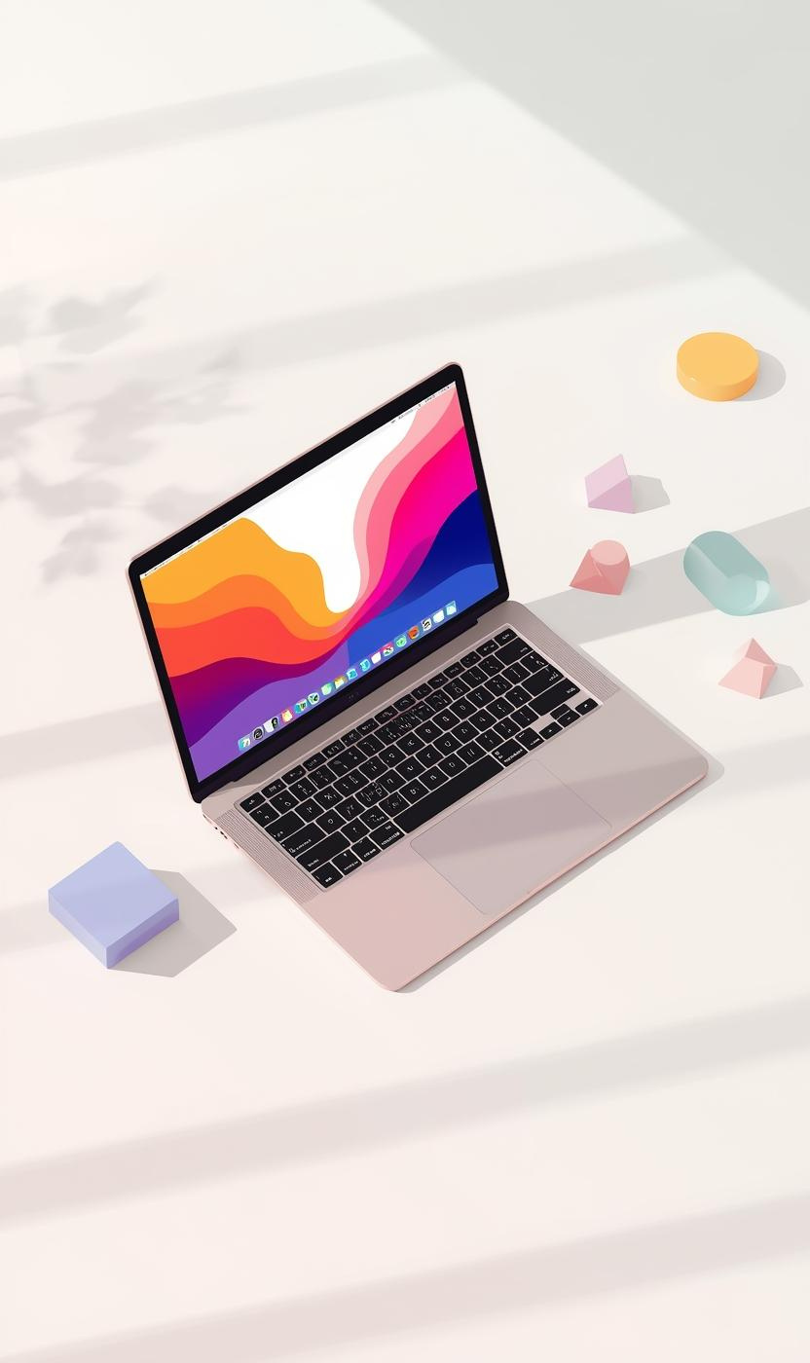
Laptop Computers: Portable and Convenient
BATTERY-POWERED TECHNOLOGY
Laptops are versatile and portable devices, allowing users to work or play from anywhere, making them ideal for students and professionals alike.

Slide 10
Other Specialized Computers
SMARTPHONES
WEARABLES
GAME CONSOLES
Smartphones are multifunctional devices that combine calling, internet browsing, and app usage, greatly enhancing connectivity and convenience in daily life.
Wearable devices, like smartwatches and fitness trackers, monitor health data and provide notifications, seamlessly integrating technology into our daily routines.
Game consoles are specialized computers designed primarily for gaming, providing immersive experiences on televisions with powerful graphics and gameplay capabilities.

Slide 11
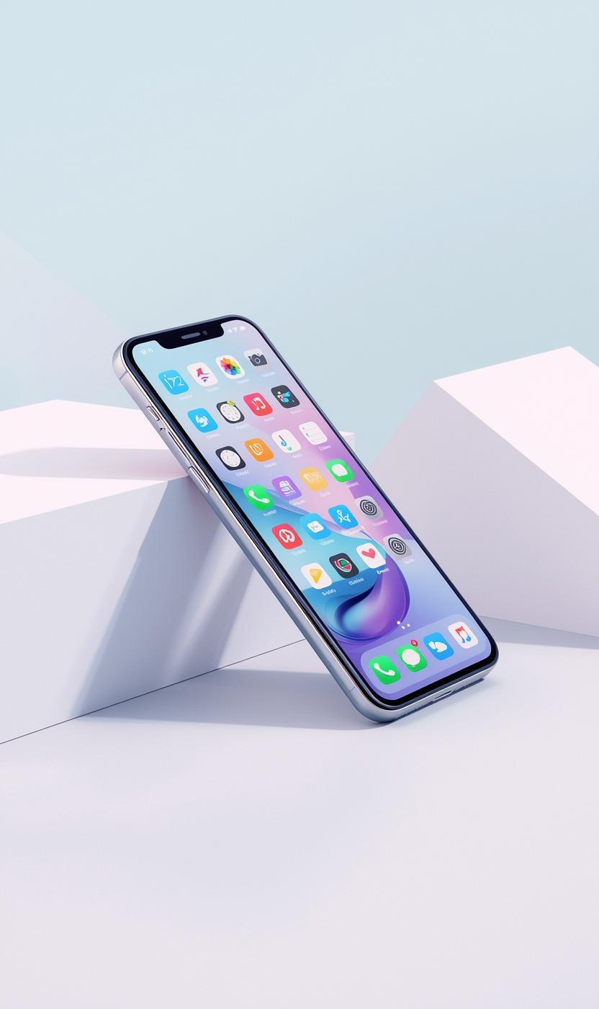
Smartphones as Modern Computers
MULTIFUNCTIONAL MOBILE DEVICES
Smartphones are powerful devices that offer Internet access, numerous apps, and capabilities, effectively functioning as portable computers for everyday use.

Slide 12


Thank You for Your Attention

